Slide 1



The virtue of outreach
— does it pay off?
Sune Toft
Cosmic Dawn Center

Slide 2
Why spend time on outreach?
"Soft" values
As an astronomer, most of our salary is paid by the public. It's only fair to give something back
We don't just do science for ourselves; we do it for humanity 😇
You learn a lot! Communicating your science to laymen requires you to really understand
It's rewarding. People are happy and thankful
Payoff
We show that our students thrive
Motivating for prospective students
Motivating for current students

Slide 3
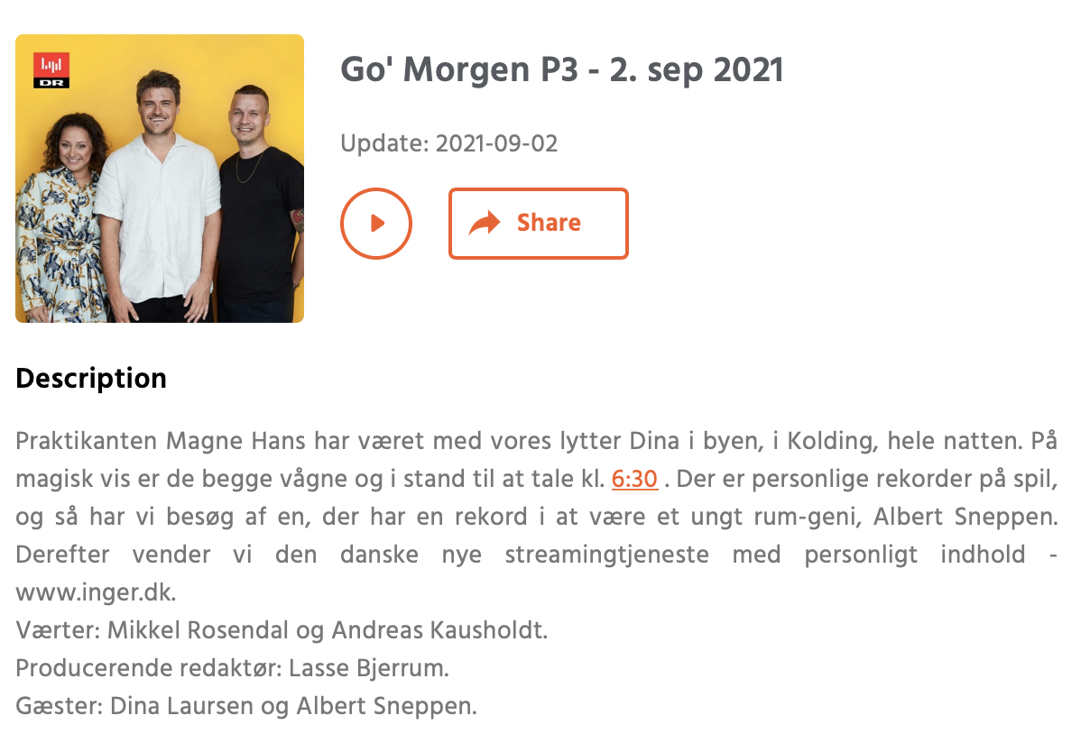
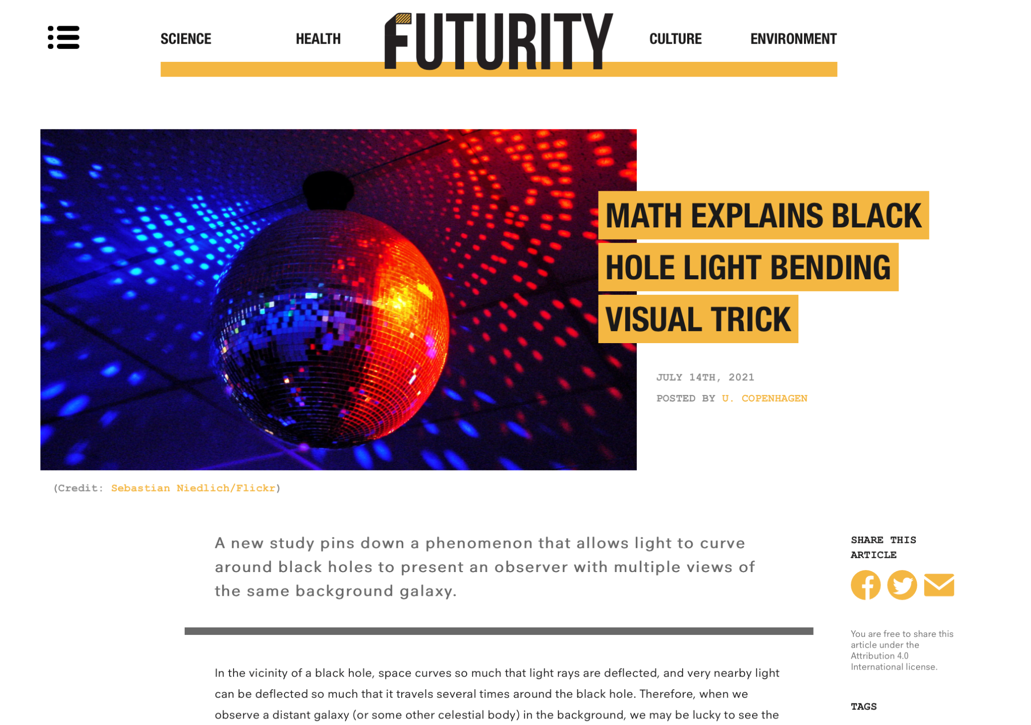
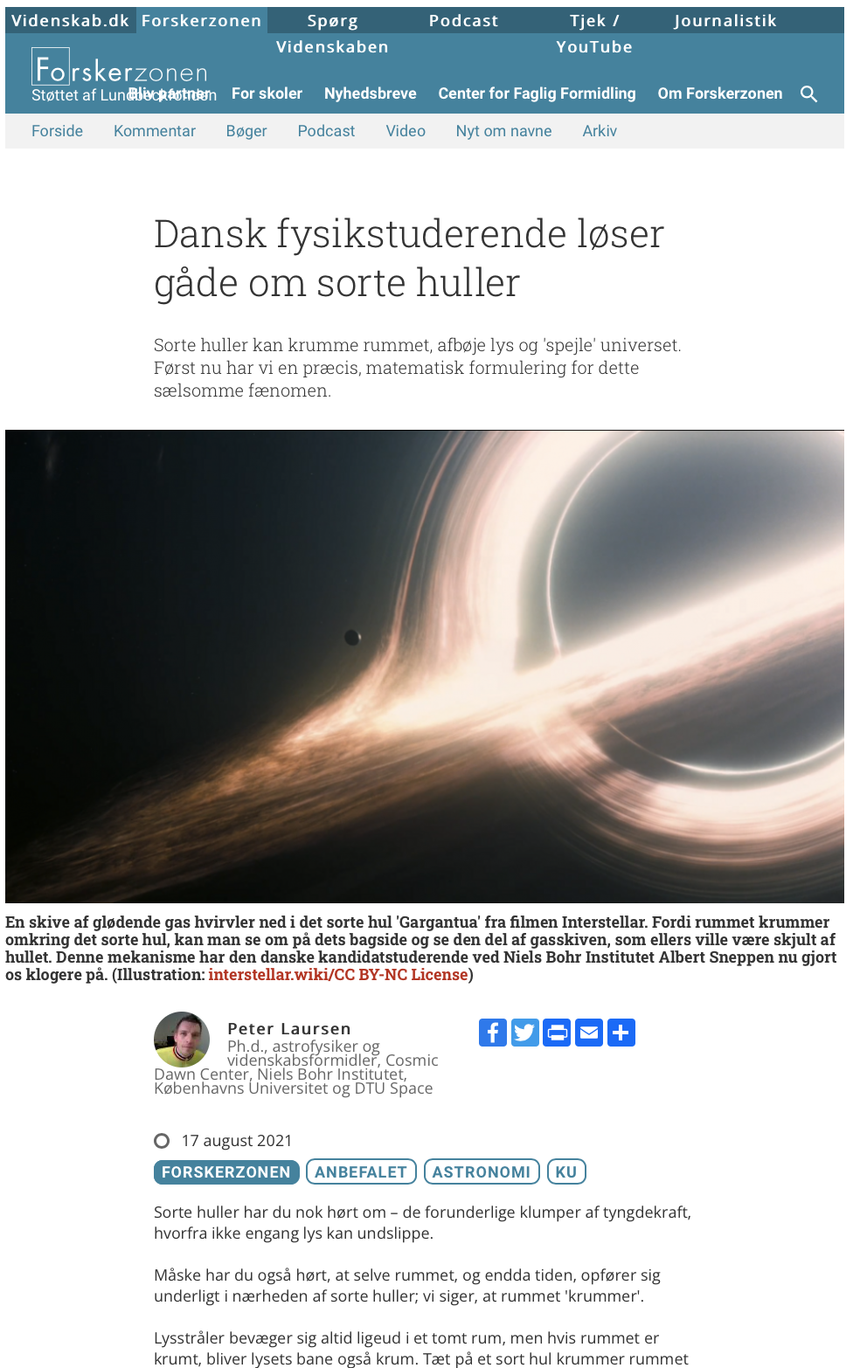
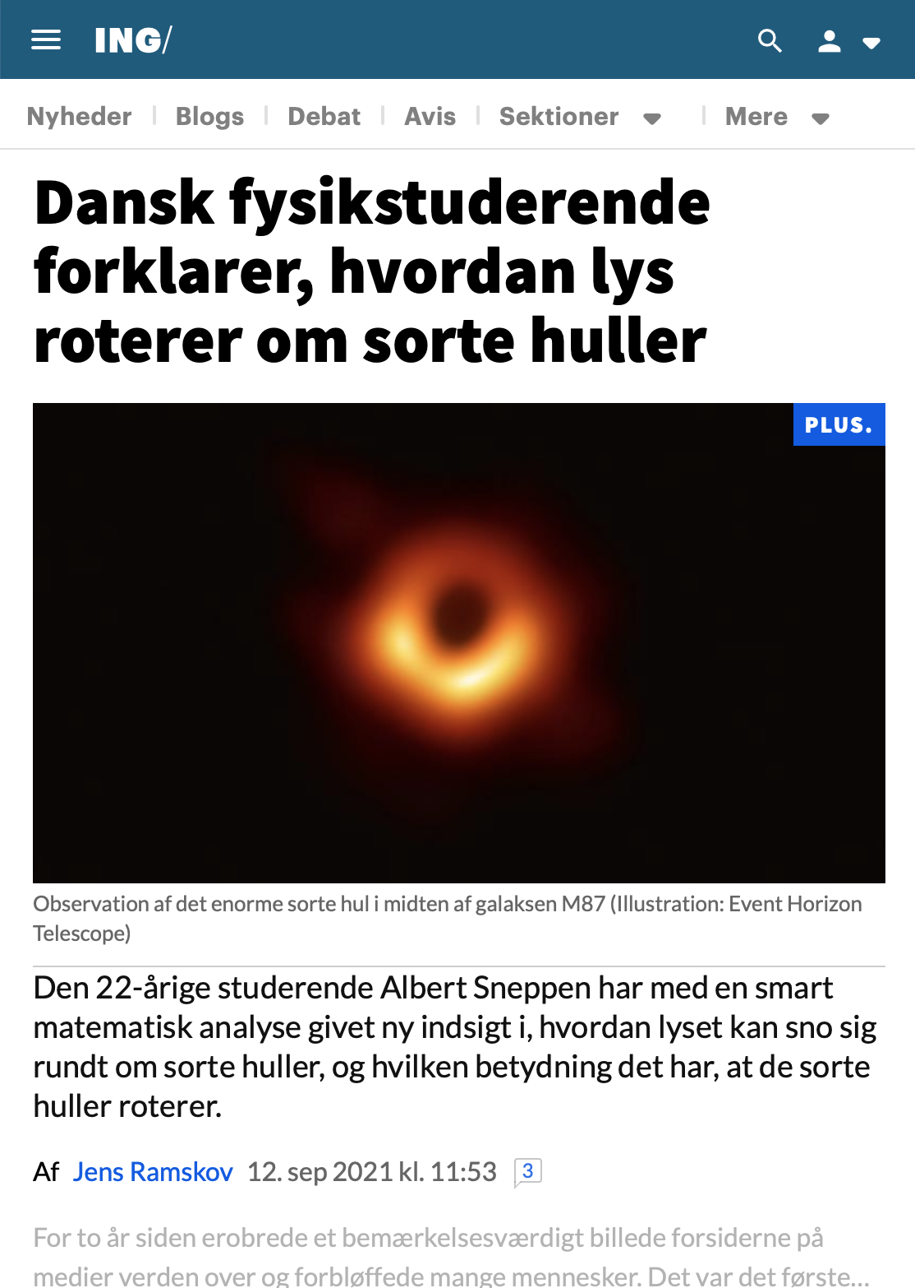
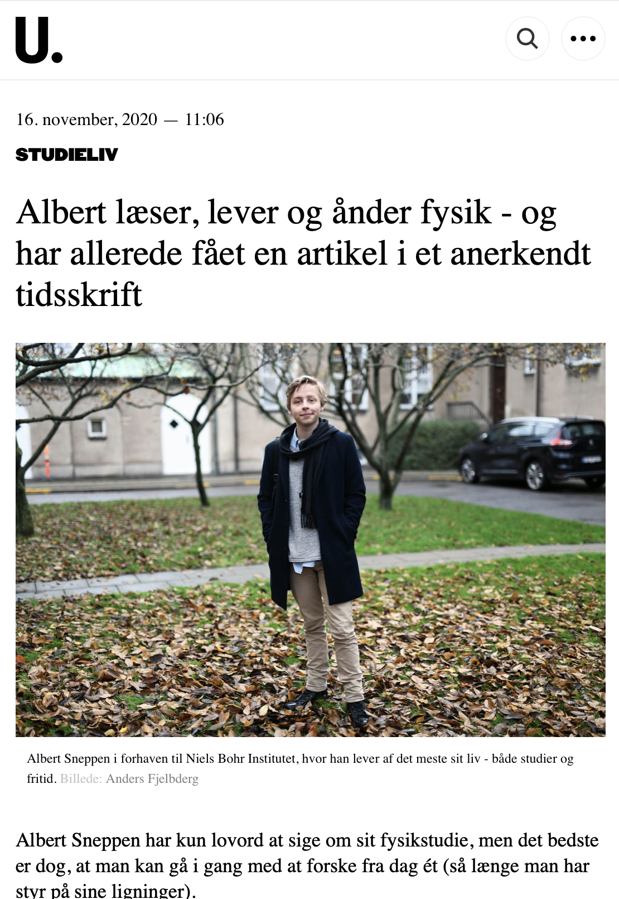
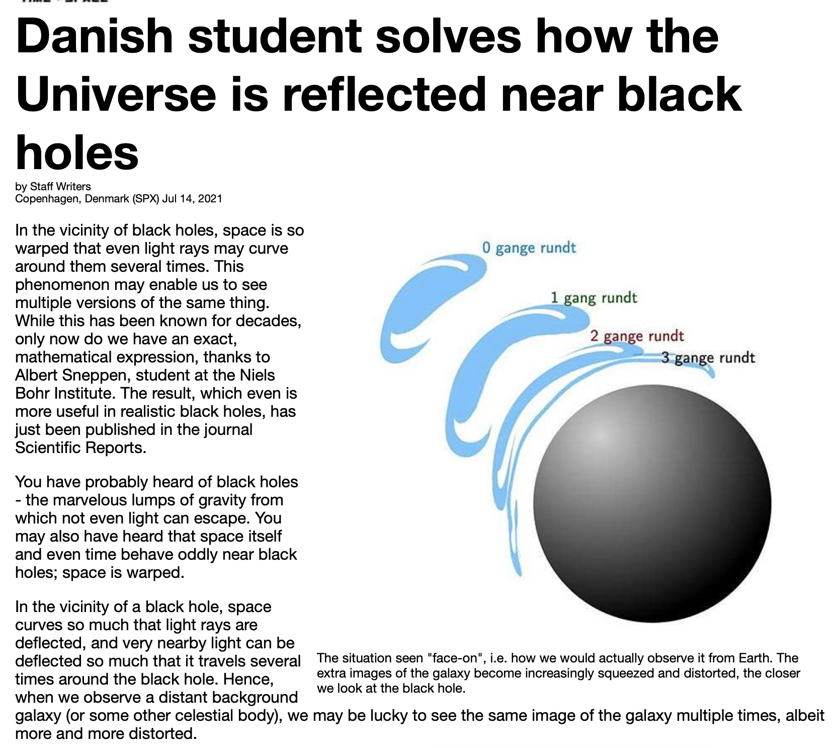
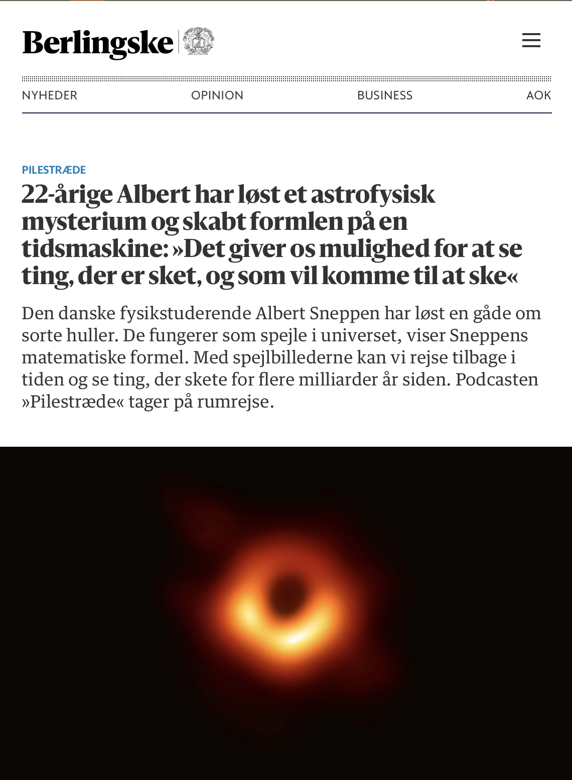
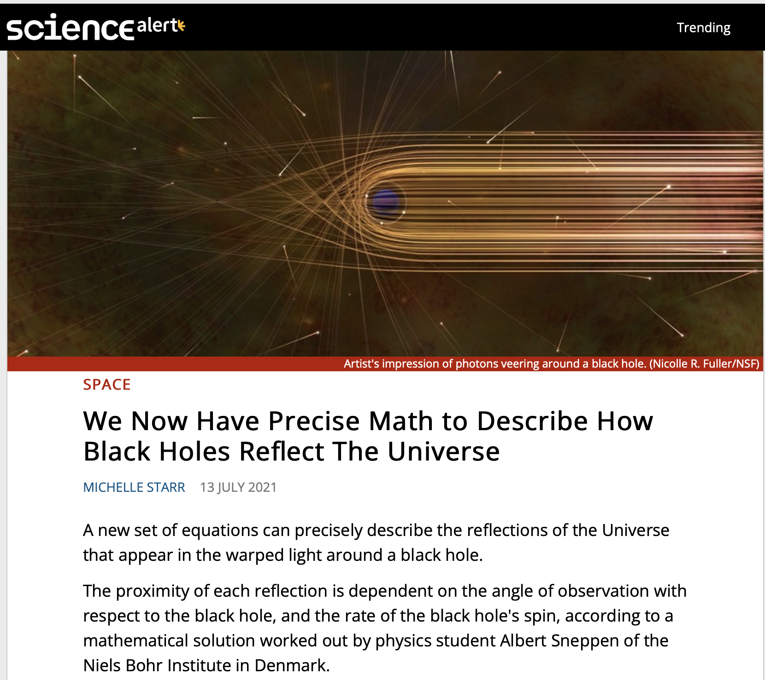
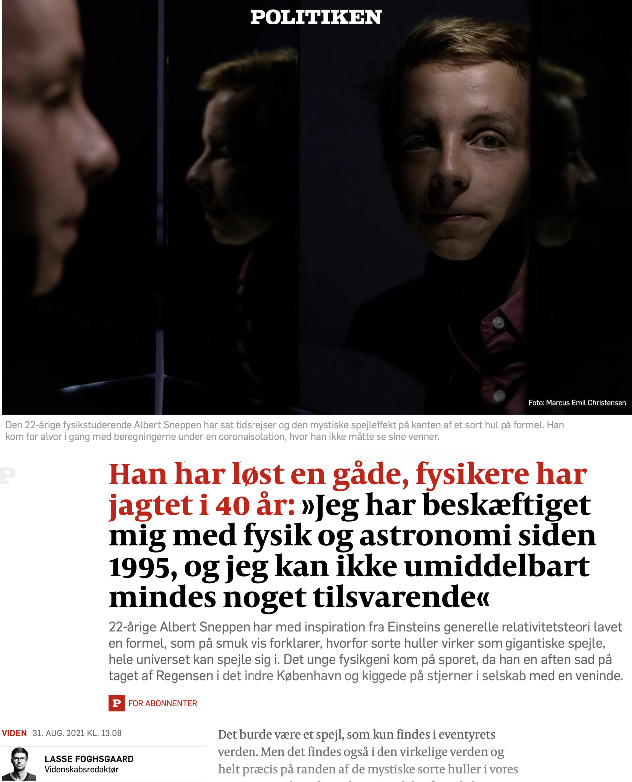
A few cases
Student Albert Sneppen
Supervised by Charles Steinhardt / SURF@DAWN, Albert wrote a 1st-author paper which got him in Uniavisen
Motivated by his success, he went on to write a single-author paper in Nature Scientific Reports. We saw to potential in the paper, and wrote a press release which went “viral”, both world-wide
and in Denmark

Slide 4
A few cases
Ass. Prof. Gabriel Brammer
Some intro
We wrote a press release
Picked up internationally
…and in Denmark

Slide 5
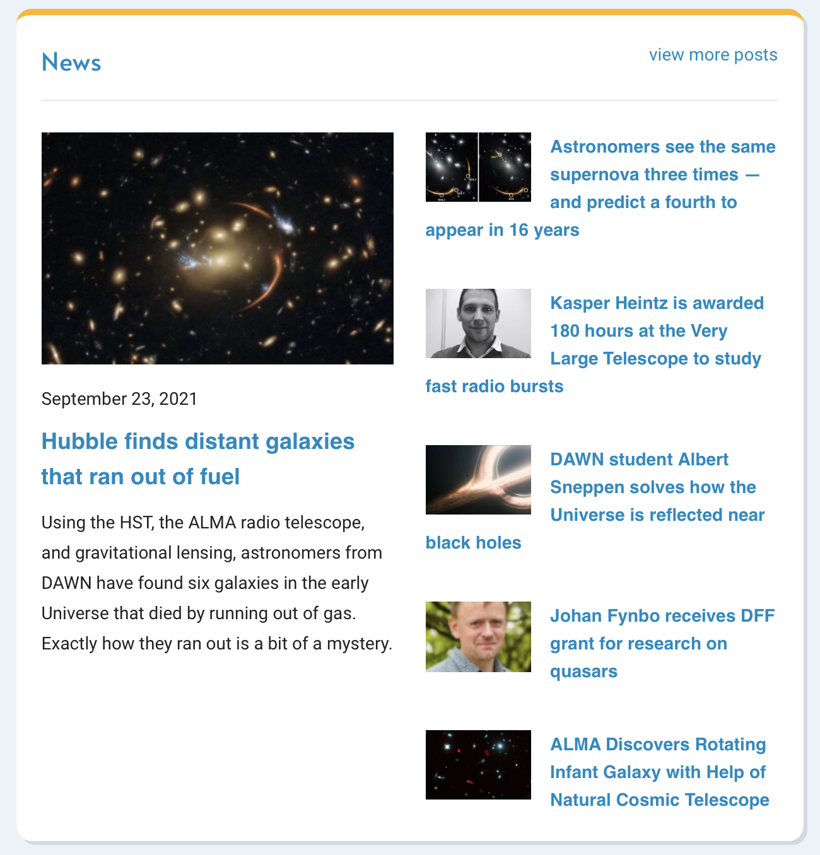
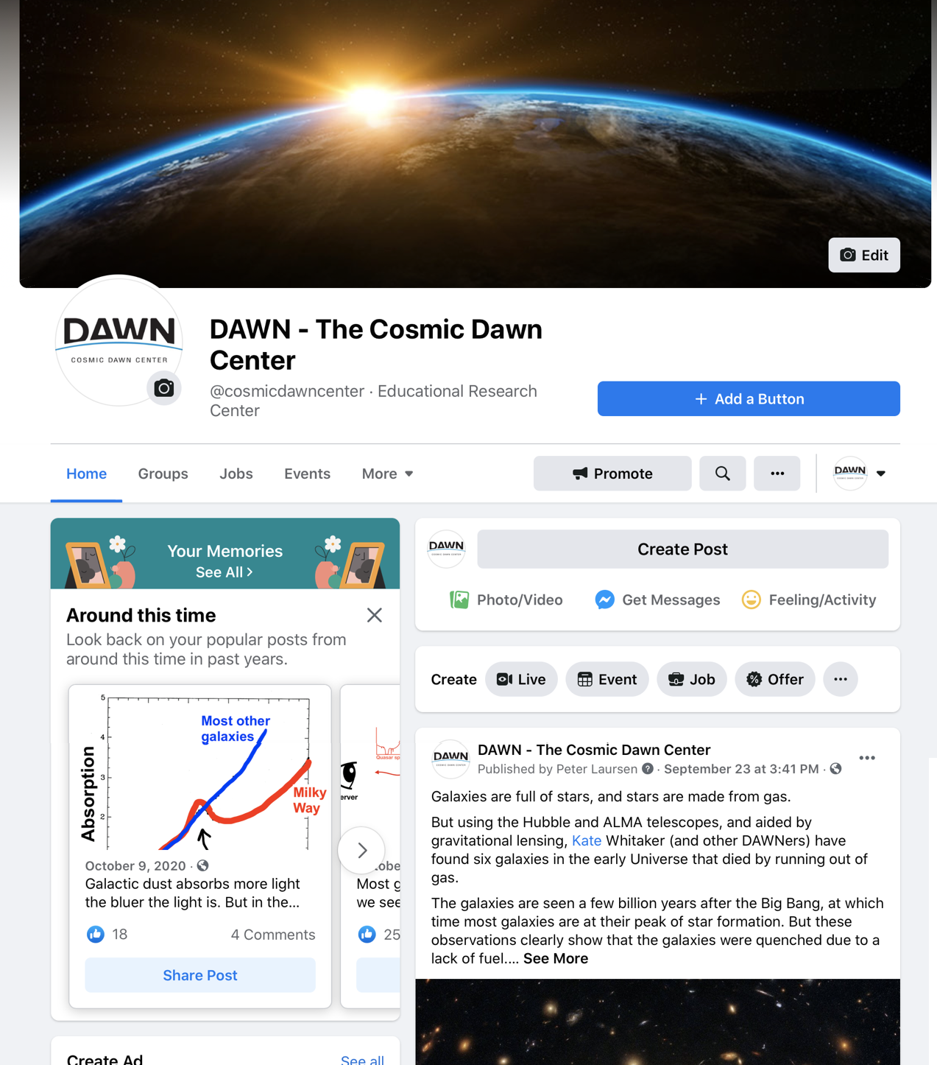
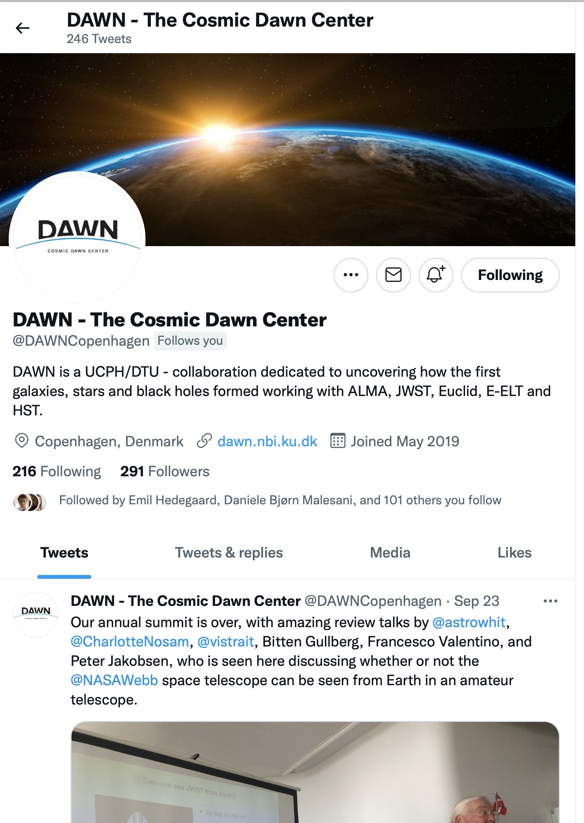
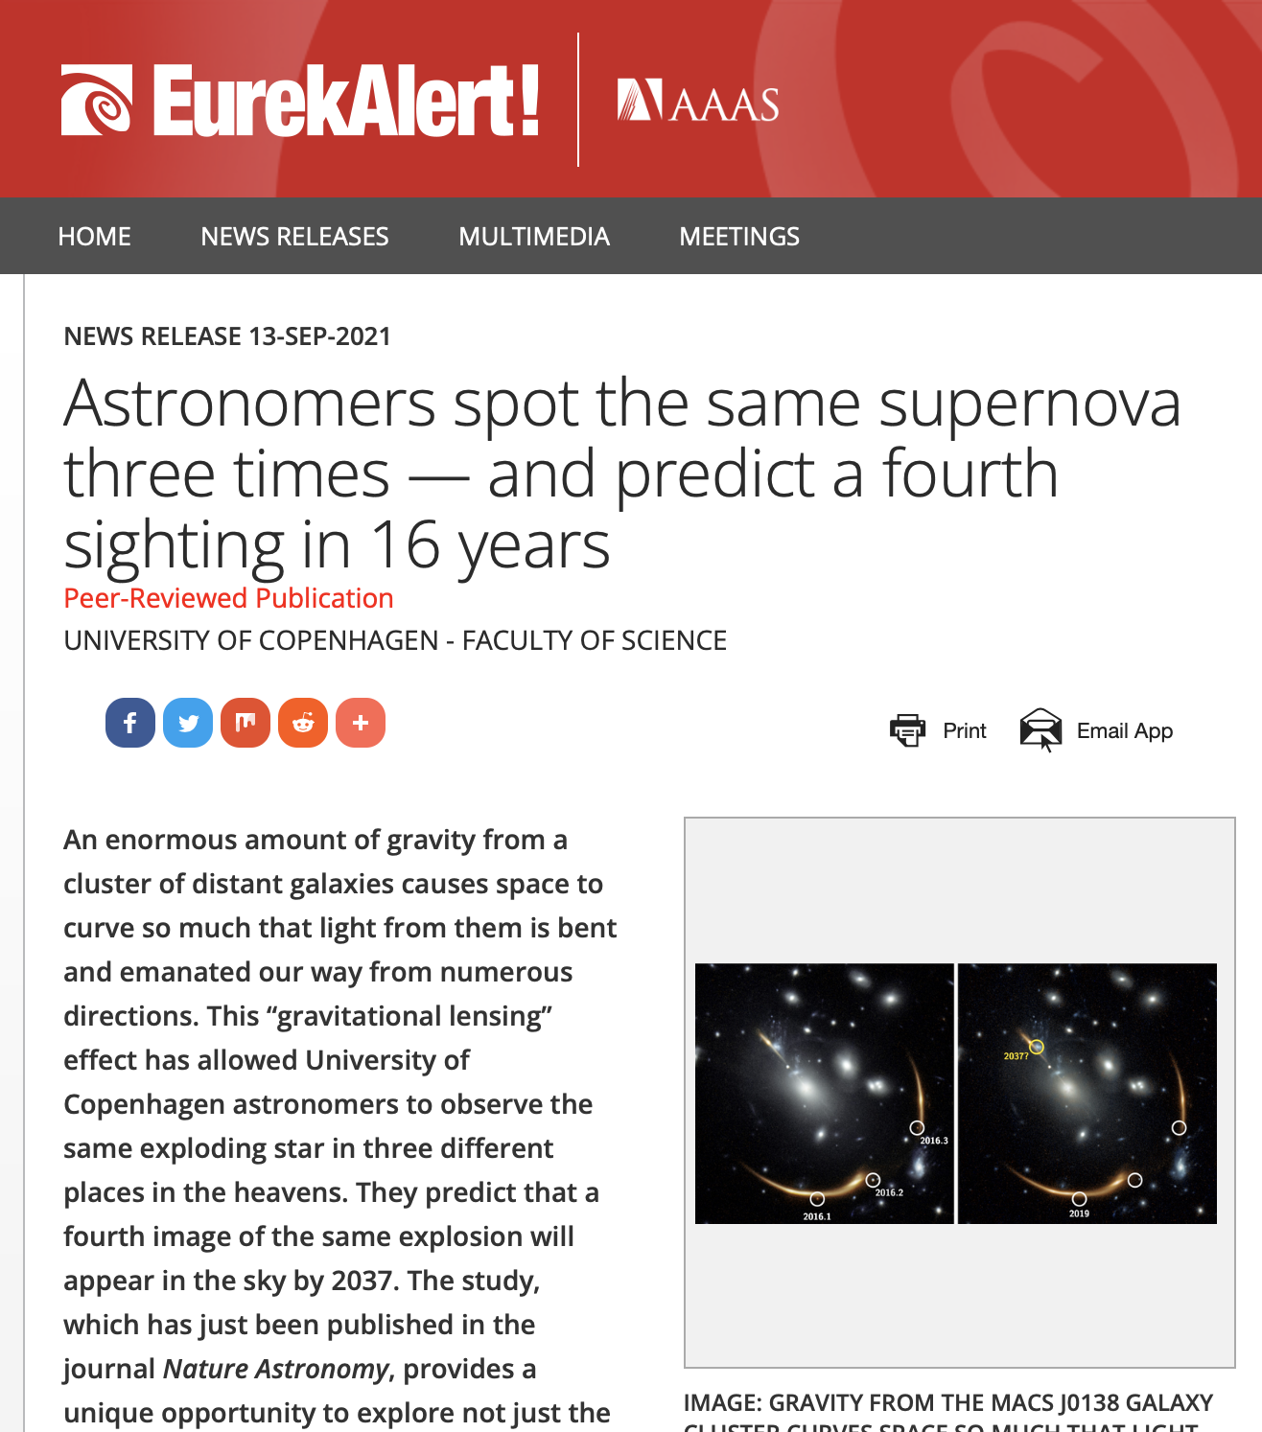
How we do it
Hire an astrophysicist dedicated to outreach
Gives researchers more time for research
Ensures that the science is correct
Helps counteract the somewhat sad trend that science usually ends up being sensational.
Target news to specific audiences
Our website: short, many new paragraphs and headings (people scan rather than read)
Facebook: Even easier, since most followers are busy non-scientist, link to the news story
Twitter: Very brief, slightly more sciencey, since most — but not all — followers are other scientists
Press releases: Quotes from scientists, phone numbers

Slide 6
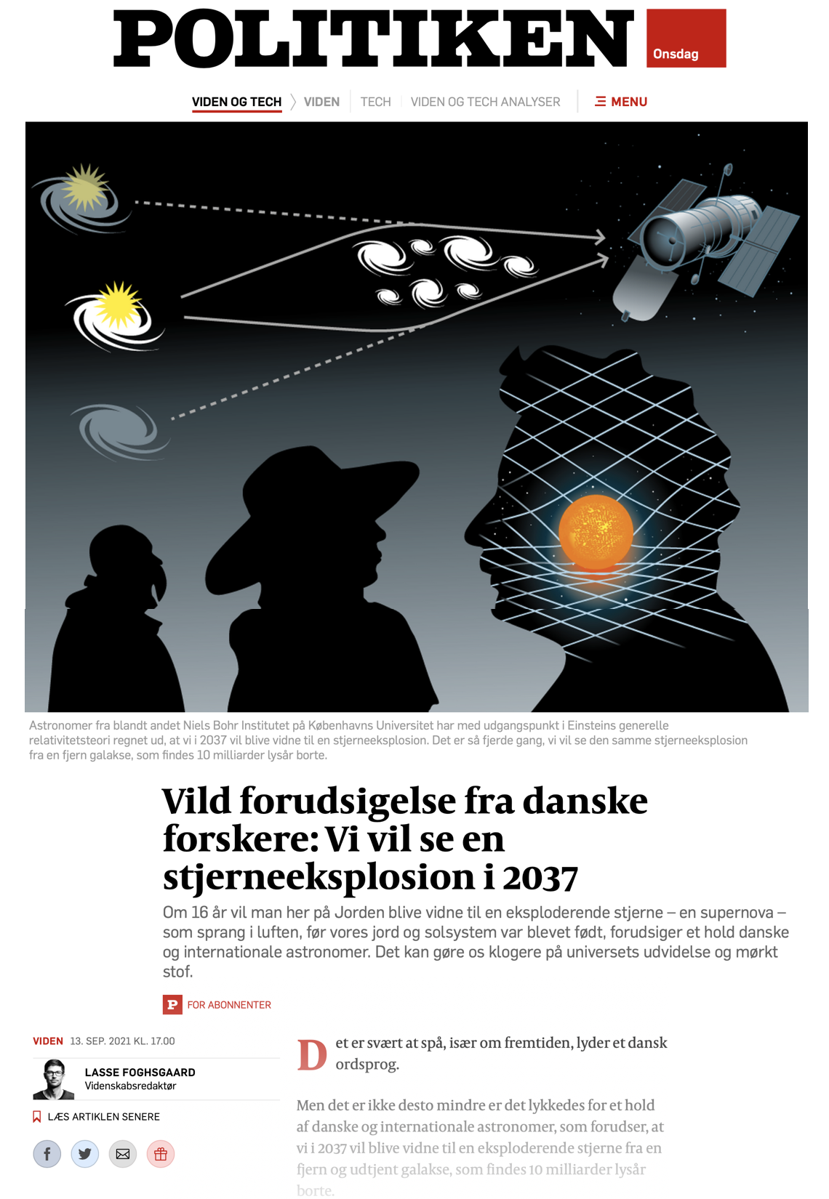
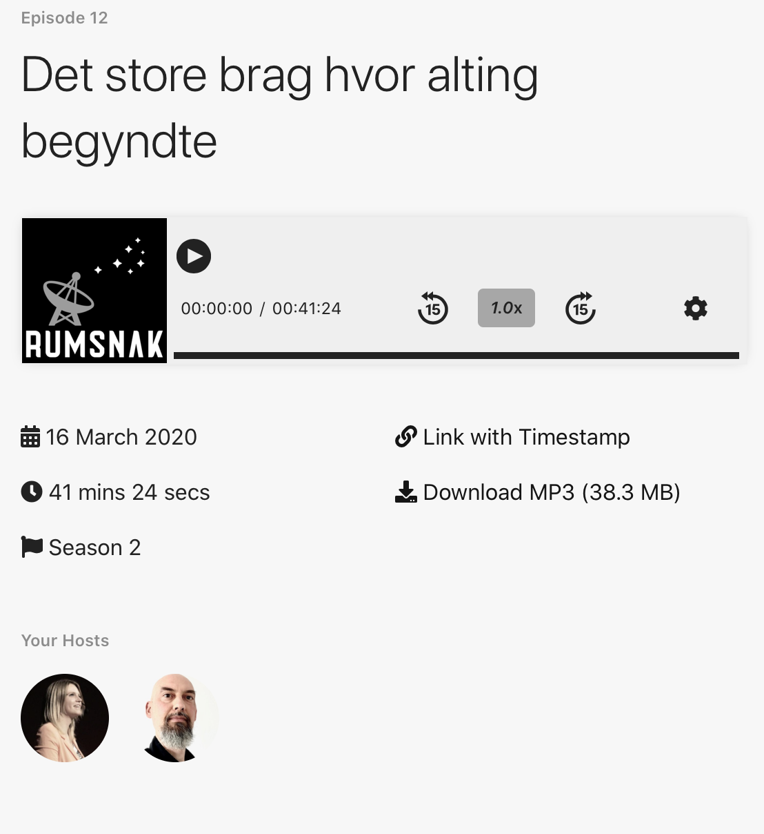
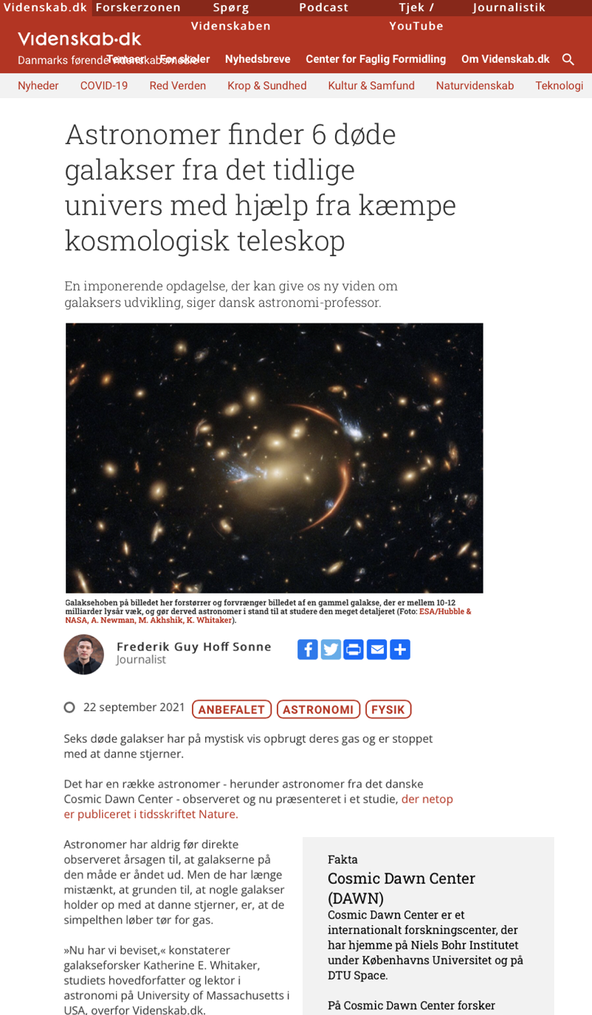
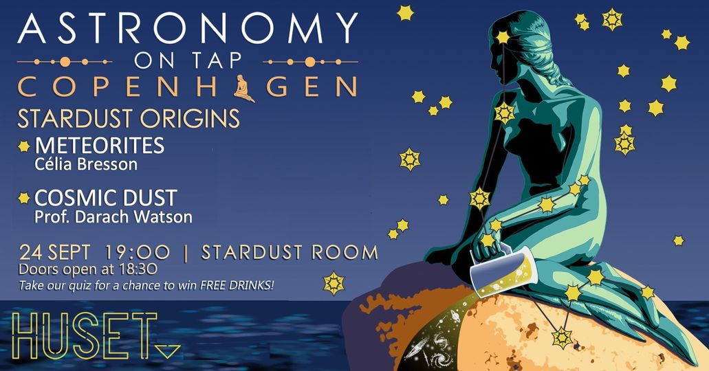
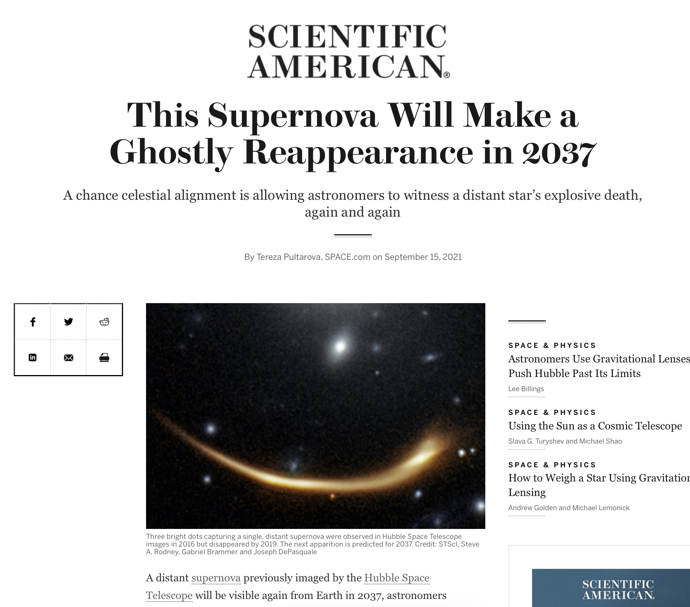
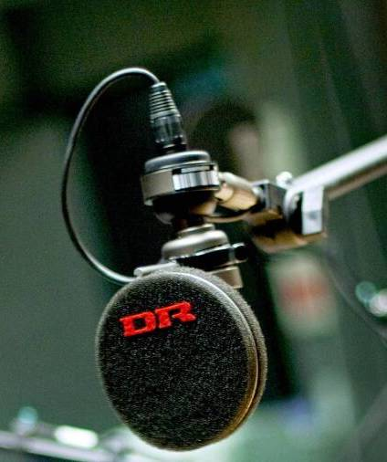
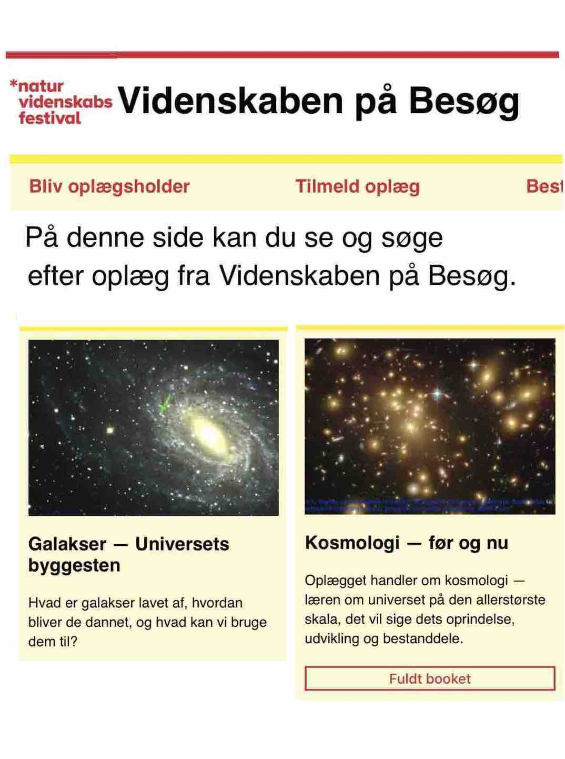
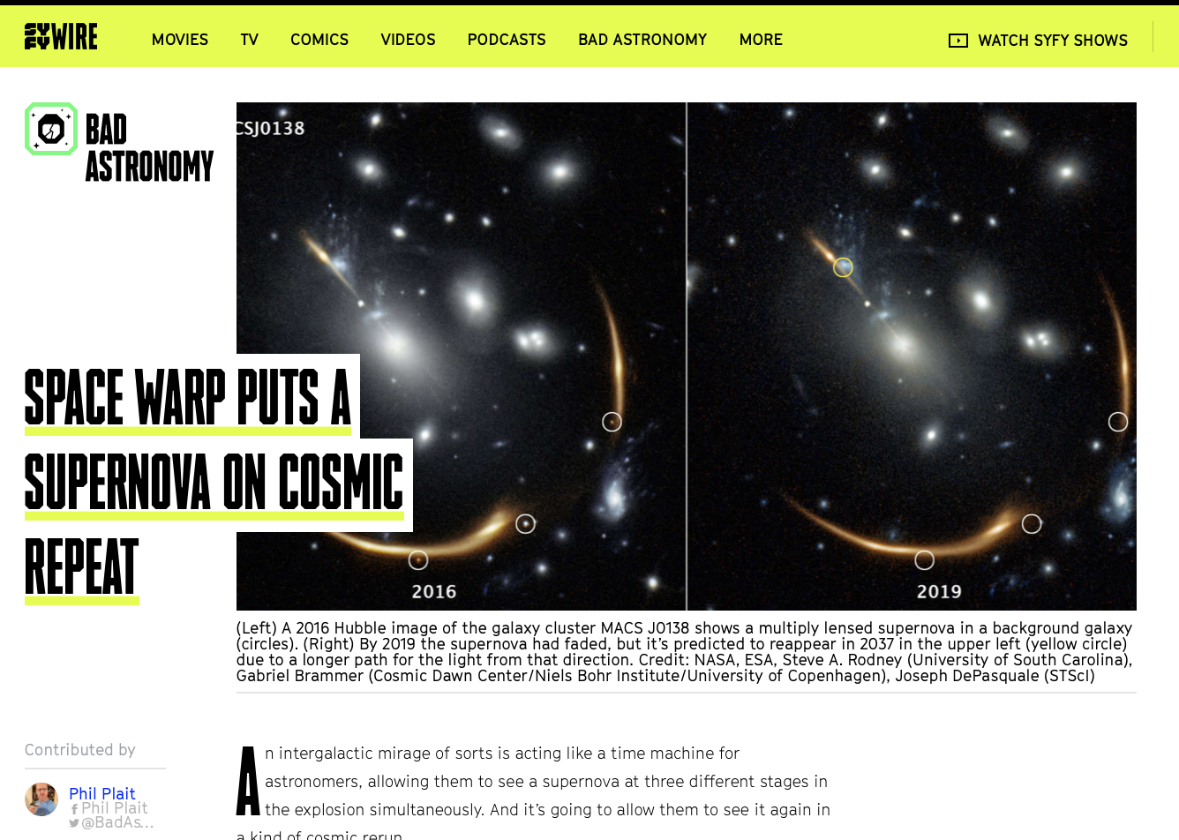
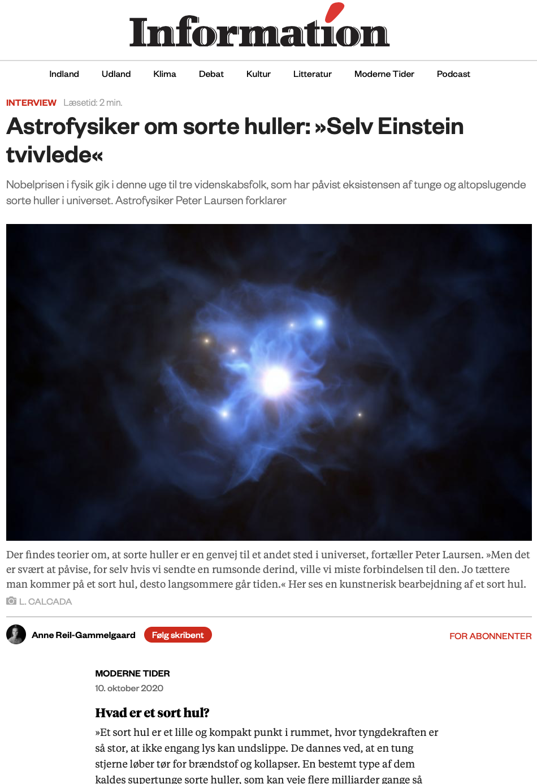
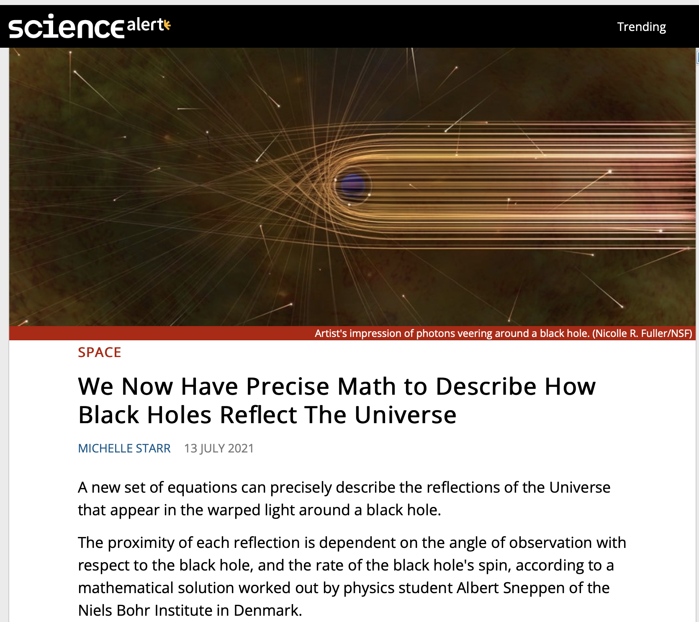
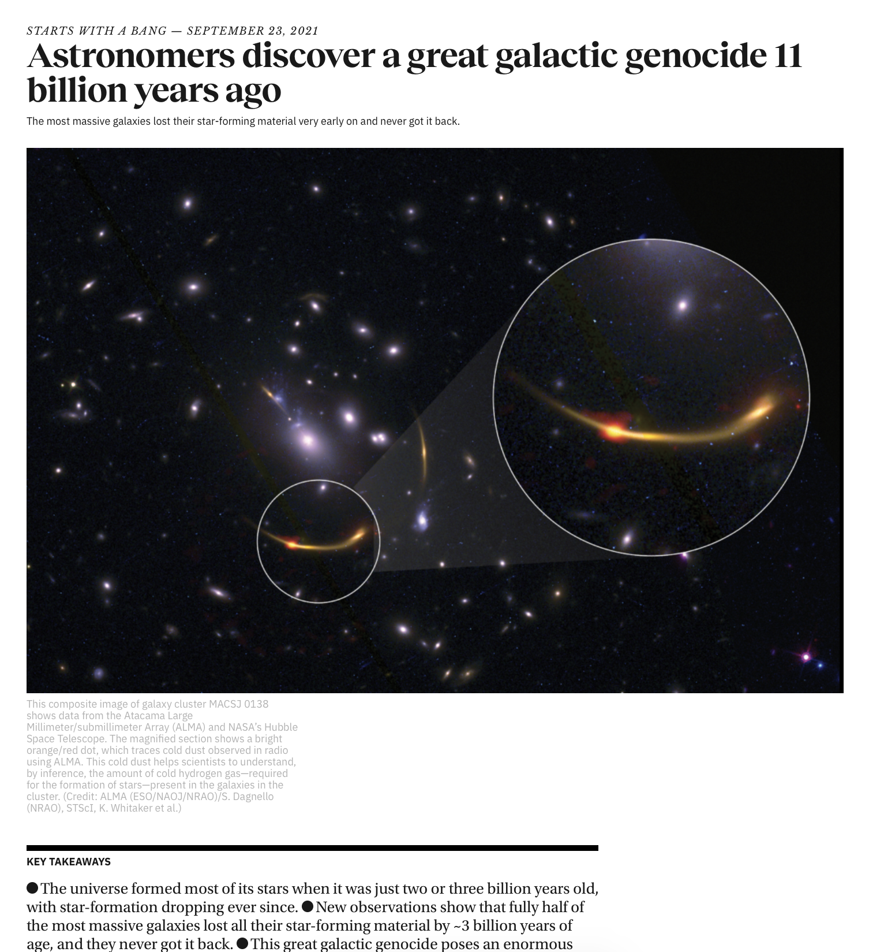
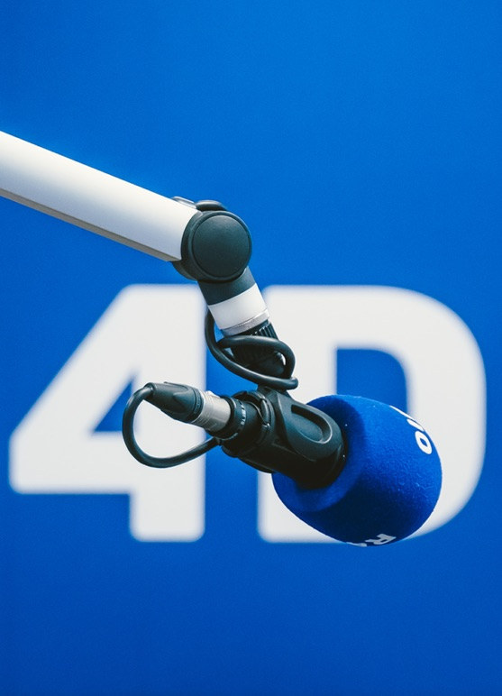

Outreach from DAWN
Public talks
High-school classes, amateur astronomy associations, libraries, pubs, kindergartens, …
In the media
Picked up from press releases or otherwise
Online science sites
Newspapers
Radio & podcast
TV
Uniavisen
Popsci articles
Q&A column
Skal ikke bruges

